Slide 2
Gravimetric Analysis
CHE 2103

Slide 3
How to Perform a Successful Gravimetric Analysis
What steps are needed?
Sampled dried, triplicate portions weighed
Preparation of the solution
Precipitation
Digestion
Filtration
Washing
Drying or igniting
Weighing
Calculation

Slide 4
Gravimetric Analysis
Introduction
1.) Gravimetric Analysis:
(i) A technique in which the amount of an analyte in a sample is
determined by converting the analyte to some product
Mass of product can be easily measured
(ii) Analyte: the compound or species to be analyzed in a sample
(iii) Overall, gravimetry sounds simple.
Advantages - when done correctly is highly accurate (most accurate of all time); requires minimal equipment
Disadvantage - requires skilled operator, slow.
Convert analyte into a solid, filter, weigh, calculate via a mole map

Slide 5
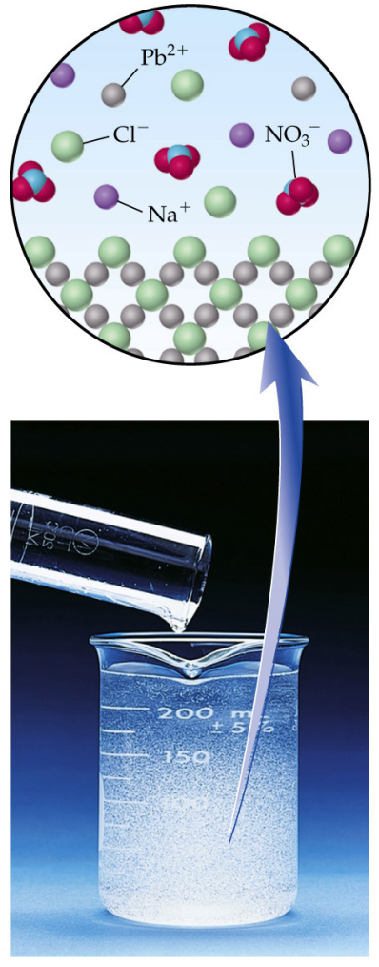
Gravimetric Analysis
Introduction
1.) Gravimetric Analysis:
(iii) Example:
Determination of lead (Pb⁺²) in water
Pb⁺² + 2Cl⁻ → PbCl₂(s)
By adding excess Cl⁻ to the sample, essentially all of the Pb⁺² will precipitate as PbCl₂.
Mass of PbCl₂ is then determined.
- used to calculate the amount of Pb⁺² in original solution
Analyte
Reagent
Solid Product

Slide 6
Gravimetric Analysis
Introduction
1.) Gravimetric Analysis:
Example Calculation:
What is the %KCl in a solid if 5.1367 g of solid gives rise to 0.8246 g AgCl?
Cl⁻ + Ag⁺ → AgCl(s)

Slide 7
Gravimetric Analysis
Types of Gravimetric Analysis
1.) Combustion Analysis
2.) Precipitation
Combustion Analysis
Common method used to determine the amount of carbon and hydrogen
One modified method (Dumas Method) can also determine the amount of nitrogen in a sample
Technique is accurate and usable with a wide range of compounds.
Often one of the first methods used to characterize a new compound

Slide 8
Gravimetric Analysis
Combustion Analysis
1.) Principals:
(i) Sample is heated in presence of Oxygen (O₂)
Converts carbon in sample to CO₂
Converts hydrogen in sample to H₂O
C_{(sample)} + O₂ CO₂
2H_{(sample)} + ½O₂ H₂O
Pt, CuO, PbO₂, or MnO₂ is used as a catalyst in this process
Δ
Pt
Δ
Pt
Ascarite

Slide 9
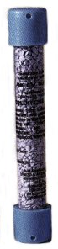
(ii) As CO₂ and H₂O form, leave the sample and flow through a series of chambers
Chambers contain chemicals that bind one or both of these products
Example:
- P₄O₁₀ can be used to absorb H₂O
- Ascarite can be used to absorb CO₂
- Ascarite - Sodium Hydroxide Coated Non-Fibrous Silicate

Slide 10
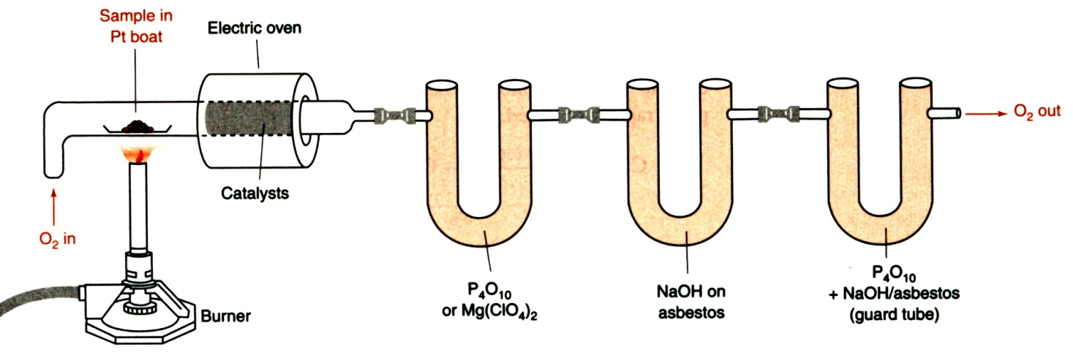
Gravimetric Analysis
Combustion Analysis
2.) Apparatus:
(i) After the sample is completely burned:
Remove P₄O₁₀ and Ascarite cartridges and weigh
If C and H are present in sample, both cartridges will increase in mass
(ii) Amount of C and H in the original sample is determined from:
Knowing the amount of sample burned
Change in weight in each cartridge

Slide 11
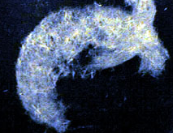
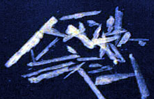

Gravimetric Analysis
Precipitation Analysis
1.) Principals:
(i)
Reagent + Analyte Solid Product (collect and measure mass)
(ii) Desired Properties of Solid Product
Should be very insoluble
Easily filterable (i.e., large crystals)
Very Pure
Known and constant composition
Few precipitates have all of these properties, but in most cases appropriate techniques can help optimize these qualities

Slide 12
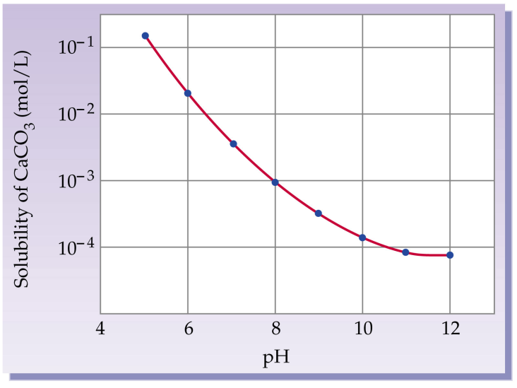
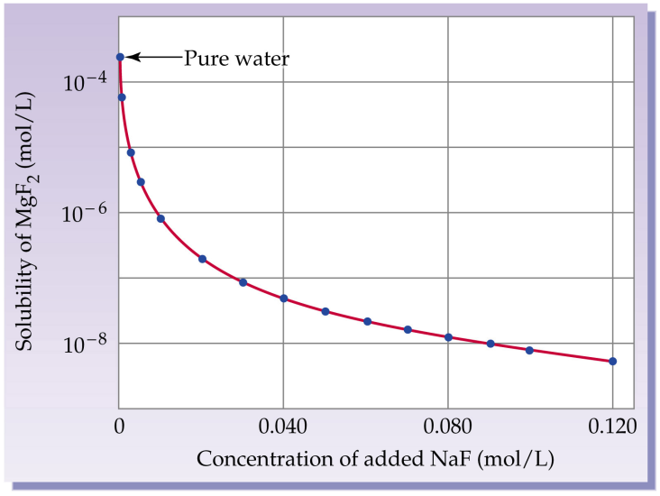
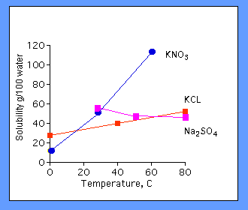
Gravimetric Analysis
Precipitation Analysis
2.) Solubility:
(i) The solubility of a precipitate can be decreased by:
Decreasing temperature of solution
Using a different solvent
- usually a less polar or organic solvent (like dissolves like)
Solubility vs. pH
Solubility vs. Common Ion Effect
Solubility vs. Temperature

Slide 13
Gravimetric Analysis
Precipitation Analysis
3.) Gravimetric Analysis:
(i) Governed by equilibrium: AgCl K_{sp} = 1.8 x 10⁻¹⁰
Solubility of AgCl = [Ag⁺] + [AgCl] + [AgCl²⁻]
Cl⁻ + Ag⁺ → AgCl(ag) ion pair formation
AgCl(aq) → AgCl(s) intrinsic solubility
AgCl +Cl⁻ → AgCl²⁻ complex ion formation

Slide 14
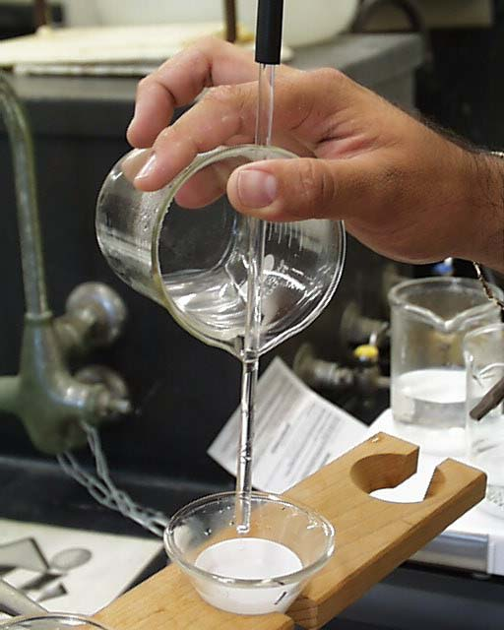
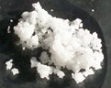
Gravimetric Analysis
Precipitation Analysis
4.) Filterability:
(i) Want product to be large enough to collect on filter:
Doesn’t clog filter
Doesn’t pass through filter
(ii) Best Case: Pure Crystals
(iii) Worst Case: Colloidal suspension
Difficult to filter due to small size
Tend to stay in solution indefinitely → suspended by Brownian motion
- usually 1-100 nm in size
Brownian Motion
Whether crystals or colloids are obtained depends on conditions used in the precipitation

Slide 15
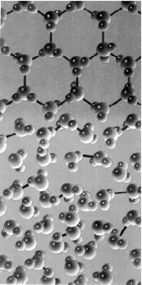
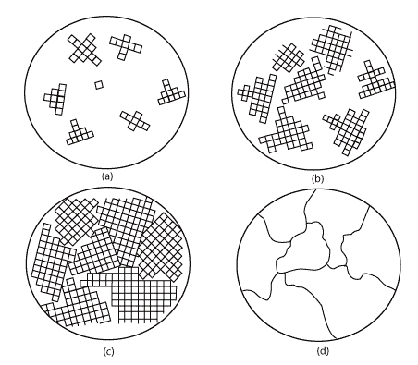
Gravimetric Analysis
Precipitation Analysis
5.) Process of Crystal Growth:
(i) Two Phases in Crystal Growth
Nucleation – molecules in solution come together randomly and form
small aggregates
Particle growth – addition of molecules to a nucleus to form a crystal
Crystal Growth

Slide 16
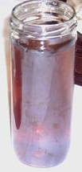
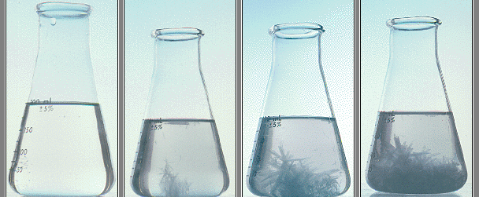
Gravimetric Analysis
Precipitation Analysis
5.) Process of Crystal Growth:
(ii) Nucleation and Particle growth always compete for molecules/ions
being precipitated.
If nucleation is faster than particle growth:
- a large number of small aggregates occur giving colloidal suspensions
If particle growth is faster than nucleation:
- only a few, large particles form giving pure crystals
Want to
Convert to
Colloidal suspension
Crystal formation

Slide 17
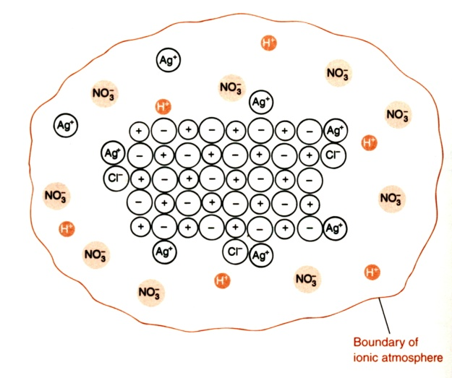
Gravimetric Analysis
Precipitation Analysis
5.) Process of Crystal Growth:
(iii) Methods for Maximizing Crystal Growth (avoid colloids)
Increase temperature of solution
- increase amount of solute that can be in solution at equilibrium
Add precipitating reagent slowly while vigorously mixing solution
- avoids local high concentrations of solution
Keep volume of solution large
- keep concentration of analyte and precipitating reagent low
Precipitate Ionic compounds in presence of electrolyte (0.1 M HNO₃)
- overcome charge repulsion and promotes particle growth
Control solubility of solute through chemical means
- by adjusting pH
- adding complexing agents
- example: precipitation of Ca²⁺ with C₂O₄²⁻
C₂O₄²⁻ + H⁺ HC₂O₄⁻
Ca²⁺ + C₂O₄²⁻ CaC₂O₄(s)
Avoid Colloidal Particle
Note: As pH ([H⁺]) changes, the solubility of CaC₂O₄ changes
K_{sp}

Slide 18
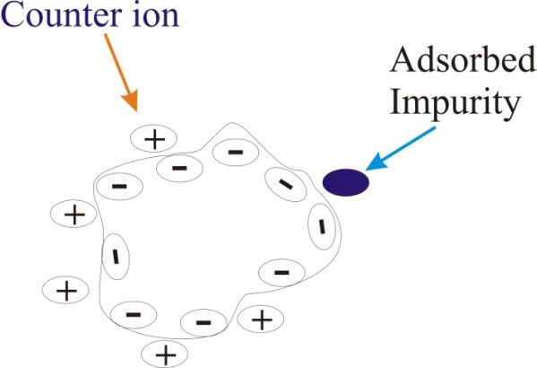
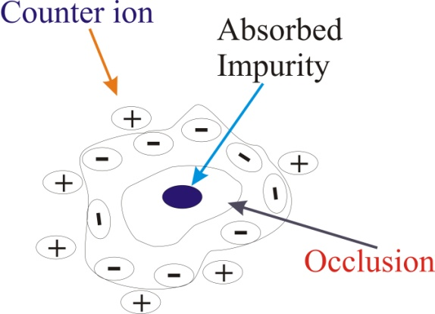
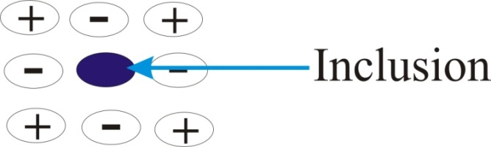
Gravimetric Analysis
Precipitation Analysis
6.) Crystal Impurities:
(i) Impurities are undesirable (known as co-precipitation)
Change the chemical composition of the precipitate
Creates errors in gravimetric analysis
(iii) Types of Impurities
Adsorption, Occlusion, Inclusion
Impurity placed in crystal instead of analyte
Adsorbed to crystal surface
Absorbed or trapped within crystal pockets

Slide 19
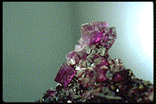
Gravimetric Analysis
Precipitation Analysis
6.) Crystal Impurities:
(iii) Ways to Minimize Impurities
Maximize crystal growth
- large pure crystals decrease occlusions and adsorbed impurities
Digestion: allowing precipitate to stand in mother liquor (precipitating solution), usually while being heated
- promotes removal of impurities from crystal
- increases size of crystals
Wash precipitate, redissolve in fresh solvent and reprecipitate
- helps decrease all types of impurities
Add a masking agent to solution
- keeps impurities from precipitating, but not analyte
Color → Impurity
Masking agent
Mg²⁺ + CPCH → Solid product
Mn²⁺ + 6CN⁻ → Mn(CN)₆⁴⁻
precipitant

Slide 20
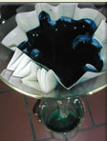
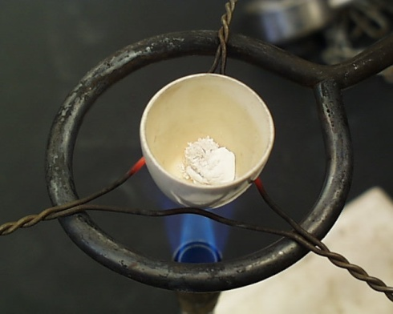
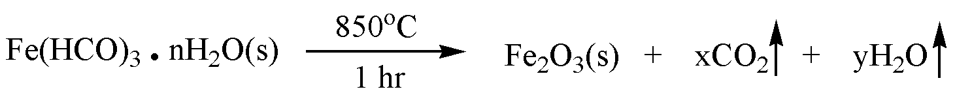
Gravimetric Analysis
Precipitation Analysis
7.) Final Preparation of Precipitates:
(vi) Washing Precipitates
Precipitates from ionic compounds
- need electrolyte in wash solution
- keep precipitate from breaking up and redissolving (peptization)
Electrolyte should be volatile
- removed by drying
- HNO₃, HCl, NH₄, NO₃, etc.
Illustration:
- AgCl(s) should not be washed with H₂O, instead wash with dilute HNO₃
(vii) Drying/Igniting Precipitates
Many precipitates contain varying amounts of H₂O
- adsorbed from the air (i.e. hygroscopic)
Precipitates are dried for accurate, stable mass measurements
Precipitates are also ignited to convert to a given chemical form

Slide 21
Gravimetric analysis uses the mass of a sample to determine the amount of substance of interest.
Precipitation is the most common form of gravimetric analysis:
Ag⁺_{(aq)} + Cl- → AgCl_{(s)}
Since K_{sp} is small (K_{sp} = 1.8 x 10⁻¹⁰) most of the silver will be removed from the solution in the form of precipitate.

Slide 22
From the molar mass and mass of AgCl , amount of Ag⁺ originally in solution can be calculated.
The accuracy depends on several factors.
1. Value of Ksp
If Ksp is large → more analyte will remain in solution and not to be included in mass of precipitate.
2. Crystal formation – crystal grow in two stages:

Slide 23
Nucleation – rapid combination of molecules to form nano scale aggregates.
Particle growth – addition of more molecules to form macroscopic particles (larger than µm scale.
Potential problems with particle formation:
1. Colloid formation – a colloid is a nano scale particle (diameter < 1 µm) that remains suspended in solution.

Slide 24
Potential problems with particle formation
Colloids are recognized by “cloudy” appearance of solution. -- colloids are small enough to remain suspended by collisions with solvent molecules.
Colloids are small enough to pass through filtration device and not be included in mass determination.

Slide 25
Potential problems with particle formation
2. Elevated temperature:
Most salts have higher solubility with
increasing temperature.
3. Co-precipitation:
Inclusion of impurities in precipitate.
Random occupation of sites in crystal lattice by
undesired species. – occurs when impurity has
similar size and charge to desired analyte.
Pockets of impurities trapped with crystal structure.

Slide 26
Solutions to potential problems
1. Digestion:
allow precipitate to form slowly in presence
of hot solvent that cools gradually.
2. Washing:
filter the precipitate and wash with pure solvent, then
re-dissolve precipitate (heating) and allow precipitate
to recrystallize slowly.
( equilibrium will favour formation of pure crystals)
3. Masking agents.
species that complex with impurities to keep from forming precipitate.
CN⁻ complexes with Mn²⁺ in analysis of Ca^{2+.}

Slide 27
Gravimetric analysis ..
1. Precipitation Method:
Dissolved analyte converted to sparingly soluble precipitate.
a). readily filtered
b). low solubility
c). converted to product of known composition (heat)

Slide 28
Precipitation methods ….
Eg:- Excess of oxalic acid (H₂C₂O₄²⁻) added carefully to measured volume of Ca²⁺ .
(i) in basic solution:
Ca²⁺(aq) + C₂O₄²⁻(aq) → CaC₂O₄(s)
(ii) CaC₂O₄(s) is collected in a filtering crucible then dried.
(iii) CaC₂O₄(s) ignitd to produce calcium oxide:
CaC₂O₄(s) CaO(s) + CO(g) + CO₂(g)

Slide 29
(iv) CaO(s) cooled, and weighed.
(v) Original concentration of Ca²⁺ is computed.

Slide 30
2. Volatilization Methods:
a) Analyte is volatilized at suitable temperature
b) Volatile product is collected and weighed.
3. Precipitates – Particle Size and Filterability
a) Colloids (b) particles (c) Crystalline Formation

Slide 31
a) Colloids - ( d = 10⁻⁷ to 10⁻⁴ cm)
- invisible to naked eye.
- not easily filtered , do not settle out of solution
(b) particles – (0.10 mm or greater)
- spontaneously settle out of solution
- readily filtered and washed free of impurities more desirable.

Slide 32
Note:- Size of particles influenced by relative supersaturation of the solution in which is formed.
Relative supersaturation =
Where:
Q = concentration of solute
S = solute’s equilibrium constant

Slide 33
Precipitate solubility
Temperature
Reactant concentration
Rate of reactant mixing
If is large → small particle (colloids)
If is small → crystalline solid

Slide 34
c. Crystalline formation:
(i) Raising Temperature (increase S)
(ii) Using dilute solution (minimizes Q)
(iii) Slow addition of precipitating agent with stirring (minimizes Q)

Slide 35
4. Mechanism of Precipitate Formation:
a). Nucleation - formation of a stable solid due to number of atoms, ions, or molecules join together.
Eg:- formation on surface of suspended contaminants (dust particles)
b). Particle Growth – growth on existing nuclei

Slide 36
If is high - rate of nucleation increases
If is low - particle growth dominates, excluding nucleation.
Note 1:- Nucleation dominates - results in a large number of very fine particles.
Note 2:- Particle growth dominates - small number of larger particles.

Slide 37
5. Gravimetric Calculations:
% Analyte =
Gravimetric Factor (GF)
GF =
Where a and b are stoichiometry of an analyte and precipitate respectively.

